Slide 1

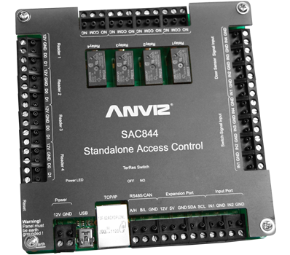
SAC844
Anviz Online Training Lesson 8
Anviz International Technical Support Team
Copyright © 2001-2013 Anviz Global Inc. USA

Slide 2
What is SAC System
- Anviz AIM SAC System is specially designed for SMEs to provide the Professional Access Control Solutions, which including SAC software, SAC 844 and T5 Reader.
- SAC: Standard Access Control.
- 8 :8 Input ports 4 :4 Relay out 4 :Support 4 Wiegand26 readers at the same time.
1. One device to control the 4 doors at the same time.
2. Plenty of Access functions, support 255 time zones and unlimited self-defined group.
3. Much more accurate time setting, to realize the members management and
temporary users Access functions.
4. Fire alarming signal input and door open, super password, stress
password.
What is SAC System
Why we call it as SAC844
Where is the difference with the old controller

Slide 3
SAC844 Specification
Parameter | Describe
Power | 12V 4A
Max/Min Current | Standby：86mA Max：560mA
Input Port | 4 Switch port ，4 Door Contact。1 fire Alarm Input
Relays Output | 4 Relay (12V 5A) （NO NC COM）
Reader | Support 4 readers (Wiegand 26 output)
Communication | TCP/IP， RS485（for Reader）, Min USB Port (firmware Update)
Size | 128*128*15mm (H*W*D)
Use Capacity | 20000 Card 1000-4000 Fingerprint (Decide by Reader)
Log Capacity | 100000 records
Anti-Pass back | Support 2-2 door Anti-pass back
First Card Function | Yes
Inter Lock | Support 2-2 door Inter lock
Verification Mode | Card, ID+Password, Fingerprint, Card+ Password
Super Password | Each Door Support 1 Super Password to open the door
Duress Password | Support 1 Duress password and special display in the record.
Time Zone | Use define 253 time zones (The Time Zone 0 and 1 is System defaulted)
Timed Task | Support Timed Task function
LED | 22 LEDs
Working Temperature | -10℃—50℃
Working Humidity | 0-80%

Slide 4
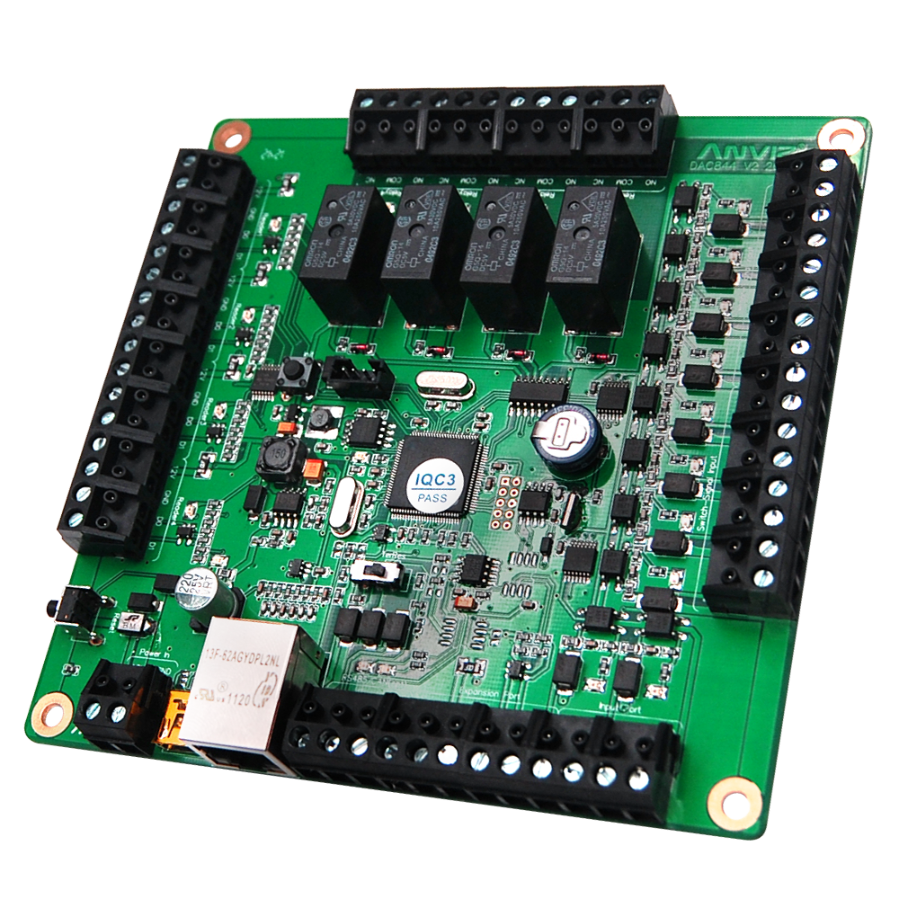
SAC844 Features
Using high-performance CPU from TI to guarantee the equipment working capability. And with rich interface to enable the device more supportive
4 Omron relay to guarantee equipment 24 hours working. Circuit isolation design to ensure input and output devices’ safety.
Various input and output ports of circuit protection measures, to reduce the controlling board’s damage from misuse of the installation process.
Dongle chips, to ensure the normal operation of the entire hardware system.
Farad capacitor using alternative lithium battery, long life battery. Ensure the long-term storage of data information.
Plug-in mounting interface,
install one time for all.

Slide 5
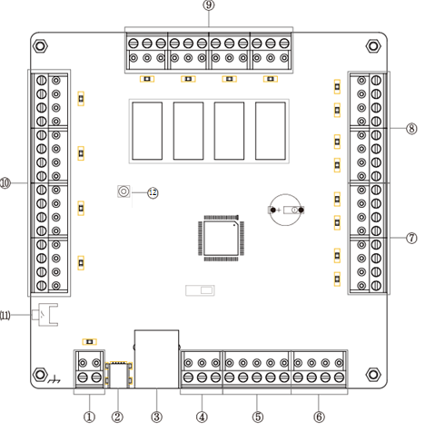
SAC844 Connection Port
NO. | Describe
1 | Power Input （DC12V 4A）
2 | Min USB port (Only for upgrade firmware)
3 | TCP/IP
4 | RS485 port (Only for new T5 Reader)
5 | I2C Expand Port（Reserved interface）
6 | Fire Alarm input
7 | 4 Switching Signal Input
8 | 4 Door Contact Input ()
9 | 4 Relay Output (NO，NC，COM）
10 | 4 Readers Input (12V GND W0 W1)
11 | Restart Button
12 | Initialization Button (Back to Default IP address)
 | Earth

Slide 6
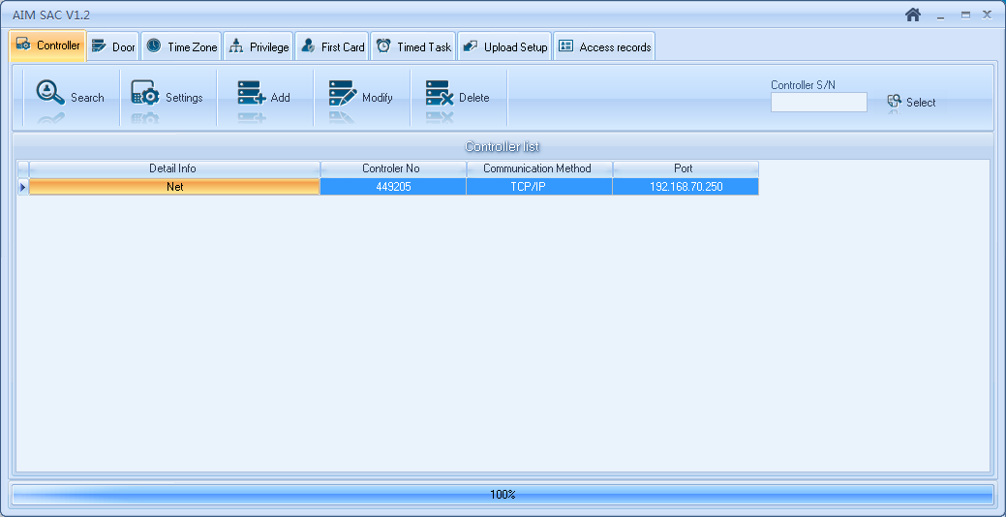
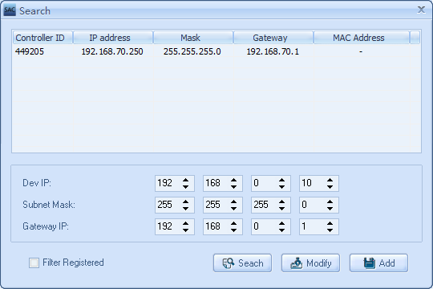
SAC844 Function
-Quick Add
To bring customers great convenience for SAC844’s first trial that the customer simply powered on and connected to the network for completing this process.

Slide 7
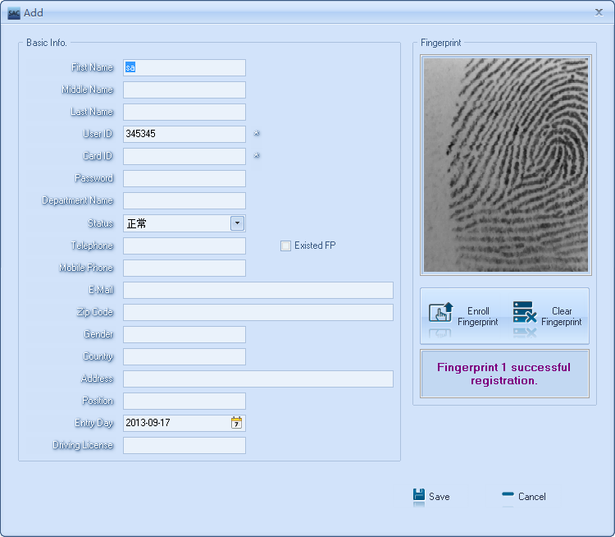
SAC844 Function
-Compatible with T5 reader
You can finish the fingerprint registration by T5 reader and U-BIO, then upload it to the corresponding fingerprint reader.

Slide 8
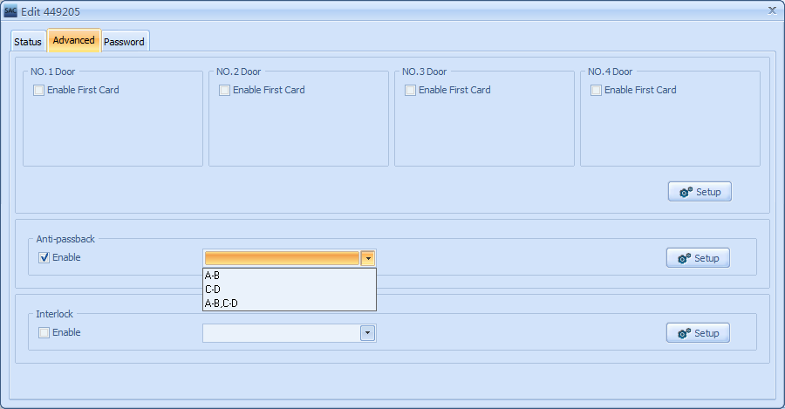
SAC844 Function
-ANTI Pass
Anti-Pass back rules can be applied to each access area to prevent one user’s card or entry code from being used for two subsequent entries, and to prevent a second entry without a previous exit.

Slide 9
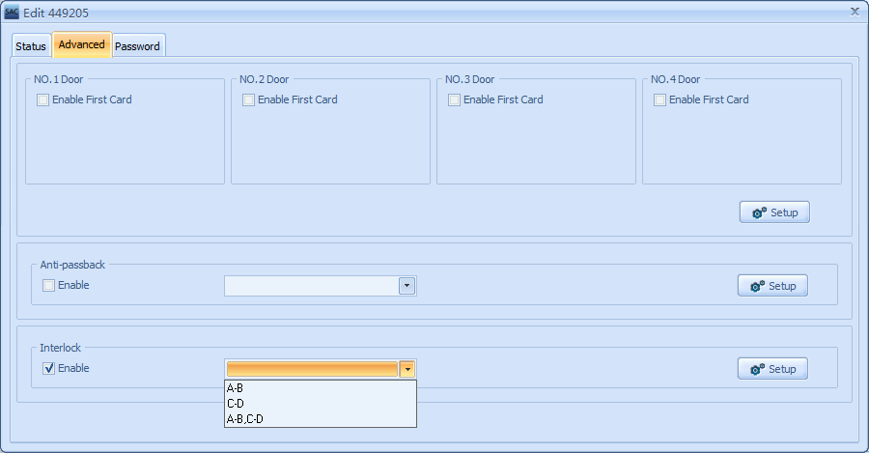
SAC844 Function
-Door Interlock
Door Interlock sometimes referred to as Mantrap, prevents two or more related doors from opening at the same time.
It may be useful for entry holes of Clean Rooms, or in other facilities with two exit door.
It should only be possible to open one door at a time with valid user code.
The Door Interlock must have door contact equipment.

Slide 10
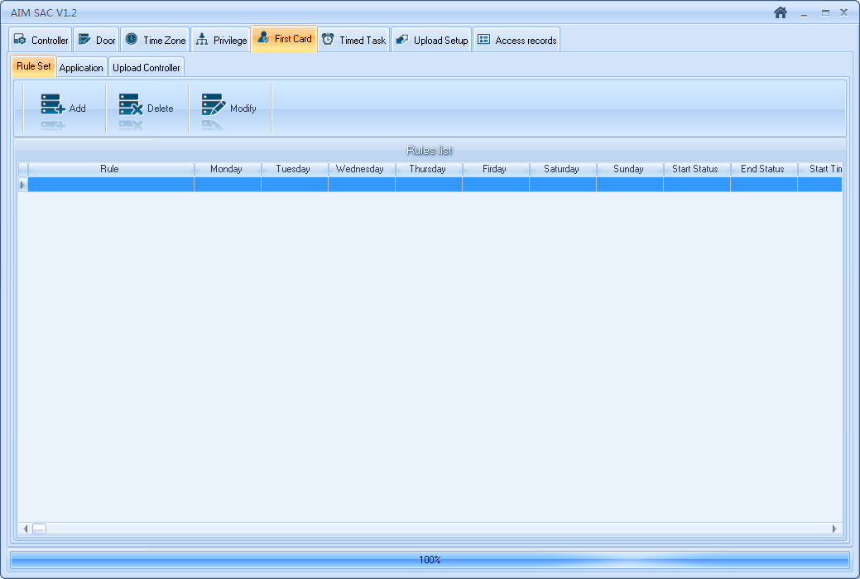
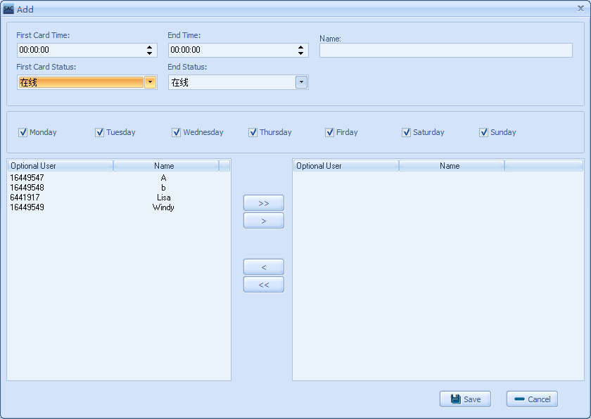
SAC844 Function
-First Card
The First Card function is that the first card has especial privilege.
After verified the first card, the door will change status.
The first card function needs setting the time and door status before activate the first card function.

Slide 11
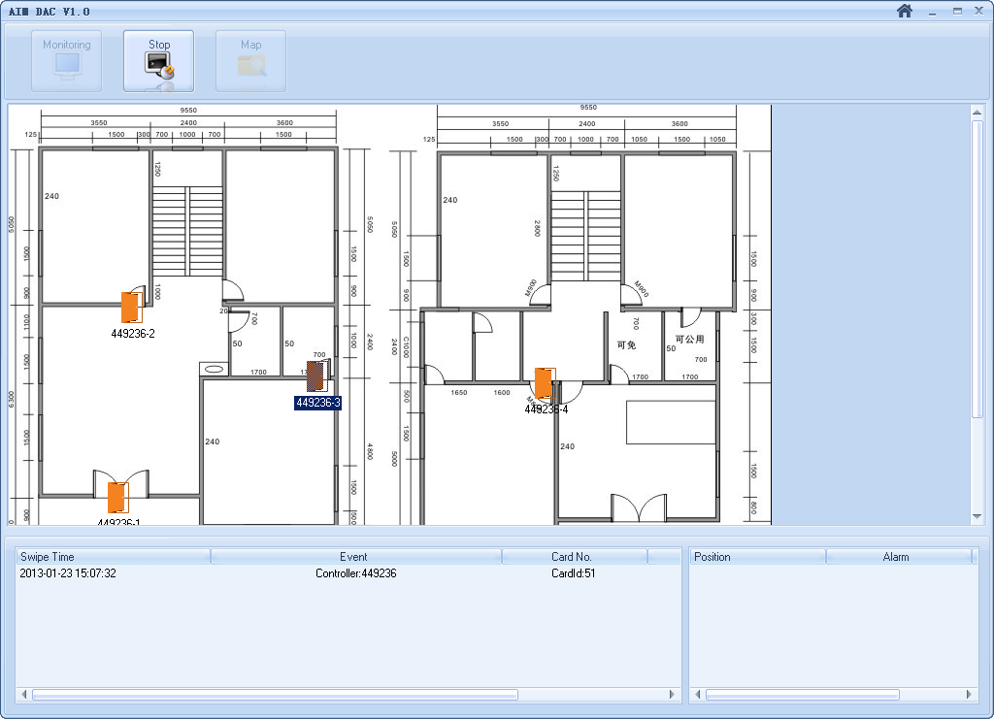
SAC844 Function
-Realtime Monitor
Monitoring user access records, Fire Alarm Record, Duress Open Door Record and Door Status (Need door contact equipment).

Slide 12
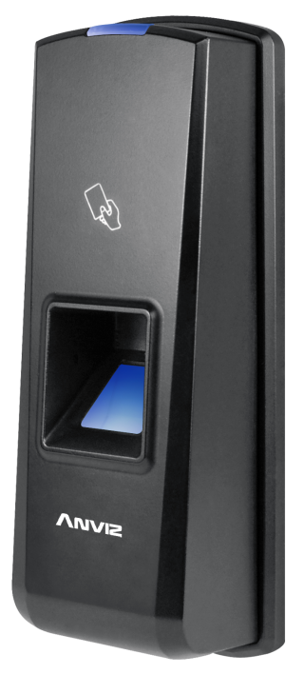
SAC System
-Components
For SAC system, Anviz recommend one specialized firmware: T5X_M_S3.05
1. No independent user registration function.
2. Direct Wiegand card number output.
3. Data exchanging from SAC844 by RS485
4. Fingerprint capacity 1000

Slide 13
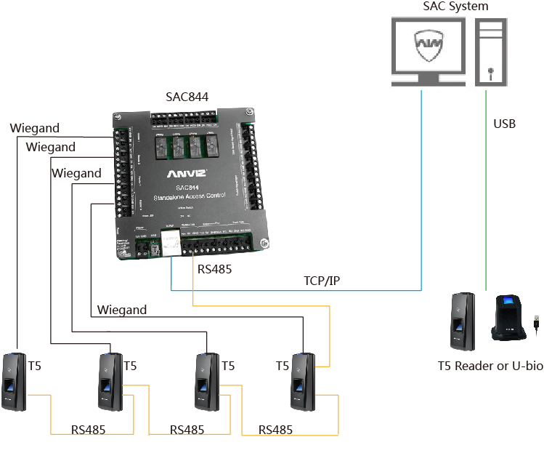


SAC System
-Components
SAC84 received fingerprint templates and after the virtual ID number, ID number stored in SAC844, and transfer the virtual number and the fingerprint template via RS485 to the appropriate above the fingerprint reader.
After a users enrolls a fingerprint in the system it generates a virtual card number, the card number and the fingerprint template is sent to the SAC844 via TCP/IP.
T5 receives the fingerprint templates and virtual ID number, and then when the user authenticates a fingerprint, the T5's Wiegand output number is the virtual ID number.

Slide 14
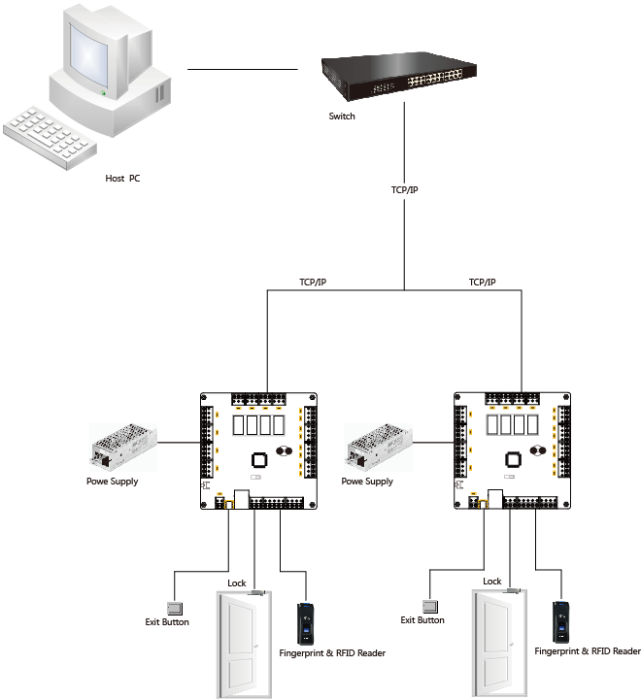
SAC System
-Topology

Slide 15
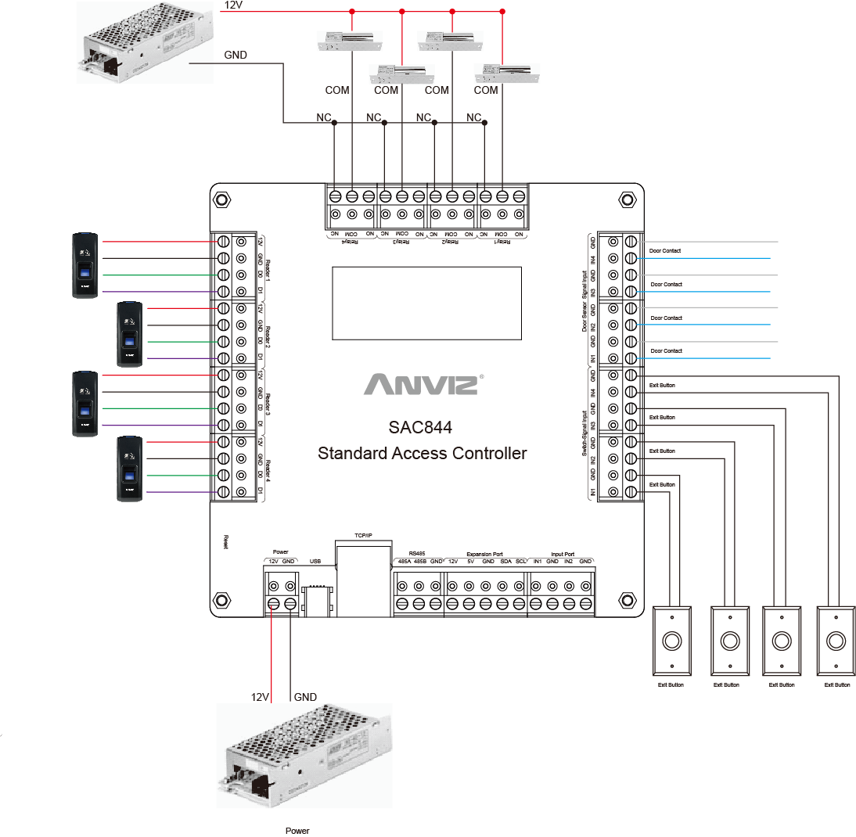
SAC System
-Connecting Diagram

Slide 16
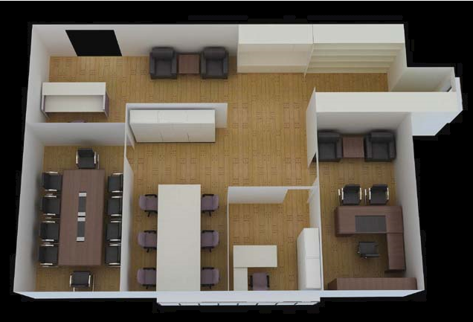

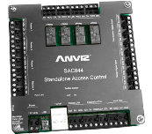
SAC System
-Application Scene Office

Slide 17
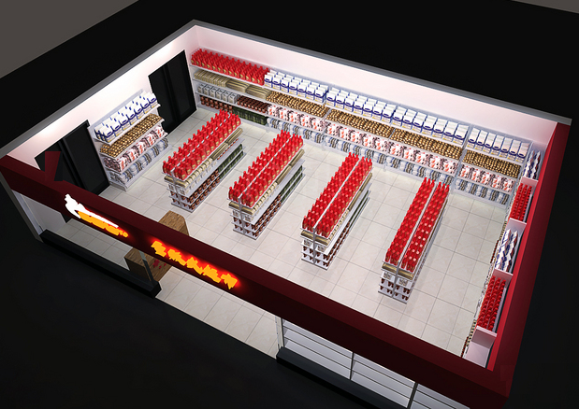

SAC System
-Application Scene Market

Slide 18

Thank You
Anviz International Technical Support Team

