Slide 1


Anviz Online Training Lesson 7
SAC844+T5+VF30
Anviz International Technical Support Team
Copyright © 2001-2013 Anviz Global Inc. USA

Slide 2
Secure the building through Access Control System
Entering and leaving of building will be registered, monitored and controlled.
Certain rooms and areas such as the elevators won’t be allowed accessing to for all the employees due to the building is used by two separate companies.

Slide 3
Products
Hardware:
SAC844
VF30(Fingerprint+Card+PW)
T5(Fingerprint+Card)

Slide 4
Products
Software:
Device Management
User Management
Real Time Monitoring
AIM_SAC

Slide 5
Products
Features:
Compact Design,TCP/IP(SAC844)
Infrared Auto Wakeup Sensor(T5)
Wiegand Input & Output(SAC844,VF30,T5)
Time Zone and Real Time Monitoring of System(AIM_SAC)

Slide 6
Project Requirements
Friendly Biometric Technology
BioNano Core Fingerprint Algorithm
High-Quality and Reliable Hardware
Excelsior Circuit Design
Special Firmware Requirement
For T5 only working as the reader
Strict Production Process
Credible Suppliers

Slide 7
Project Requirements
Installations
VF30 and T5 are inside the building for providing access control to offices and areas.
VF30 is located at all entrances of the building for fingerprint, card or pw identification.
SAC844 are situated in each floor of the building and connected to the Network.
AIM_SAC provides configuration of the system such as registration and time zone.

Slide 8
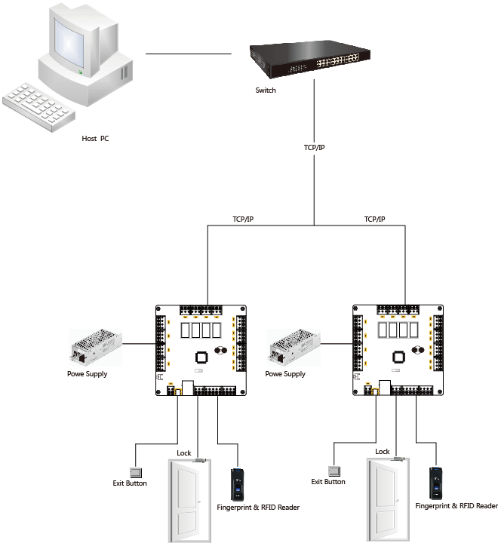
Anviz State-of-Art Solution
LAN+SAC844+T5&VF30:

Slide 9
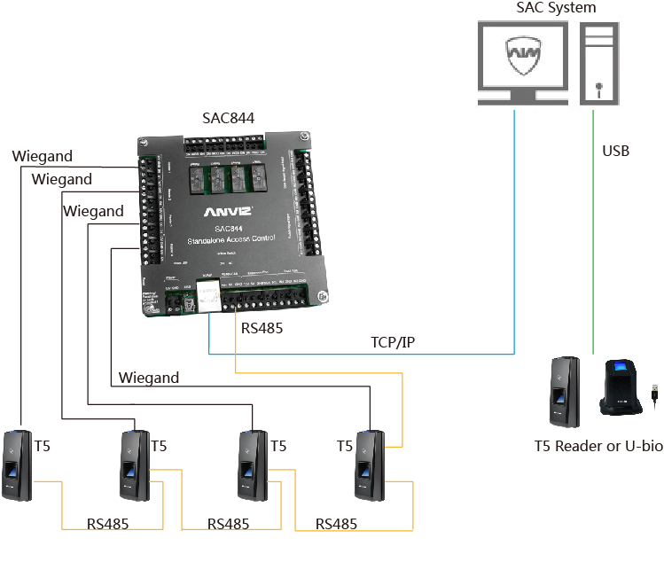
Anviz State-of-Art Solution
SAC844+T5&VF30:

Slide 10
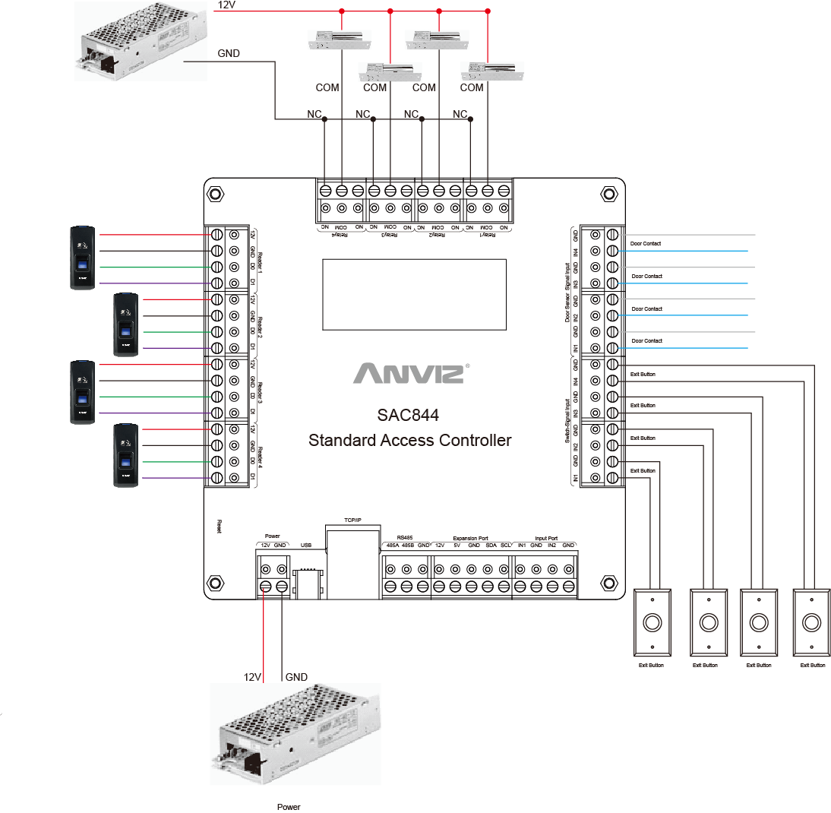
Anviz State-of-Art Solution
Interfaces of SAC844:

Slide 11
Anviz State-of-Art Solution
Registering
T5 or U-Bio for registering fingerprint and inputting card number
Granting Privilege
Set specified door privileges for specified users
Uploading Information
Uploading privileges to SAC844
VF30 for registering fingerprint, card and pw

Slide 12

Thank You
Anviz Overseas Technical Support Team

