Slide 1

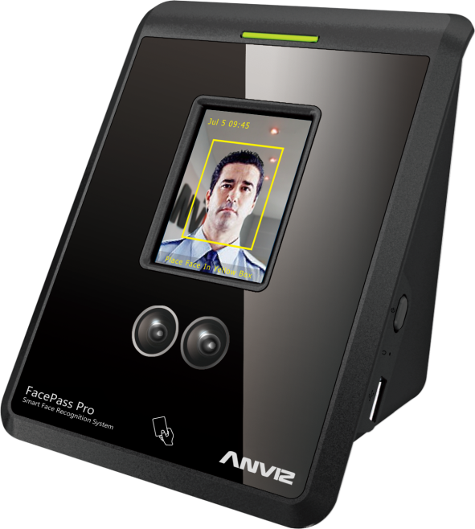
Anviz Online Training Lesson 9
Facepass Pro
Anviz International Technical Support Team
Copyright © 2001-2013 Anviz Global Inc. USA

Slide 2
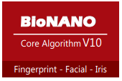
Facepass Pro Algorithm
1. Match specific features to template.
2. Use the Principal Component Analysis.
3. Intelligent self-learning function, dynamically change the face database.
4. Skin Texture Analysis turns visual details of the skin such as the unique lines, patterns, and apparent spots in a person’s skin into a mathematical space.

Slide 3
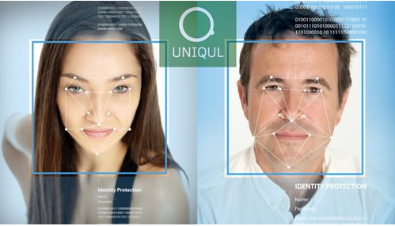
Basic Working Theory
If you have the painting basis, you would very easily understand the above shot.
The device would build the reference points on the user face.
These points would generate one network combined of Triangle.
Calculate the Geometry vector, to convert the Analog signal to digital signal.
In order to improve the face pass verify successfully rate, the device would obtain 10 faces for one user. From different angles, the photo display all has the little difference.
The face pass is really different from the Fingerprint device. When you do the FP verification, you could put your finger on the FP sensor module to execute the authentication process.
But for face pass, we could not press our face into one plane surface to obtain the biometric template.
According to this base, you need to register your face from different angles, also the close side, the far side to build the user face template since your face log in area is not fixed.

Slide 4
Specification
Parameter | Description
Camera | Dual Cameras
Display | 2.8 Inch 2408320 TFT LCD Touch Screen
Visual indication | Dual color LED(red/green)
Verify Mode | Face, Card, ID + Password,
Capacity | 400 Users
Attendance Records | 100,000
Verify Speed | <=1s(1:400)
Recognition Rate | >=99%
FAR | <=0.1%
Angle Range | Level: ±20°， Vertical:±20°
Verify Distance | 30-80CM
Communication | TCP/IP, USB Pen Drive
Embedded Webserver | Yes
Audible indication | Voice Prompt
Tamper Alarm | Yes
Auto wake/sleep | Yes
Time | Inbuilt Real Time Clock,(SNTP)
LED | 22 LEDs
Working Temperature | -10℃—50℃
Working Humidity | 0-80%

Slide 5
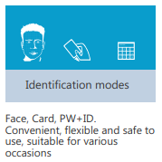
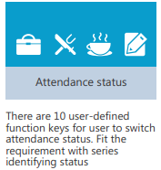
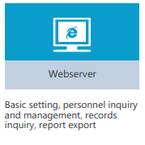
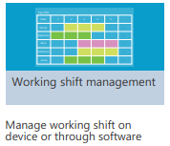
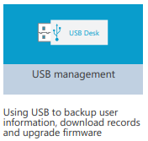
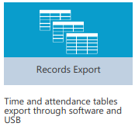
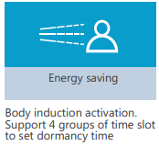
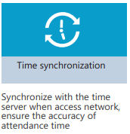
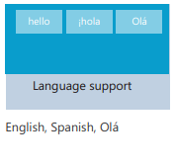
Functinos

Slide 6
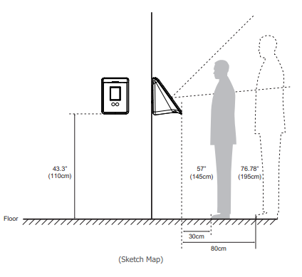
Installation and Dimension
Note
Facepass is suitable for different users’ heights and complexions. Please note that keep the face image in the center of the screen display when verification.

Slide 7
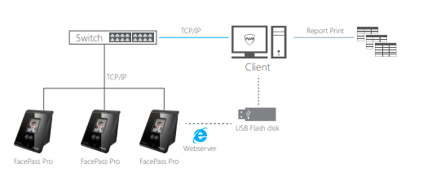
Network Topology Ilustration

Slide 8
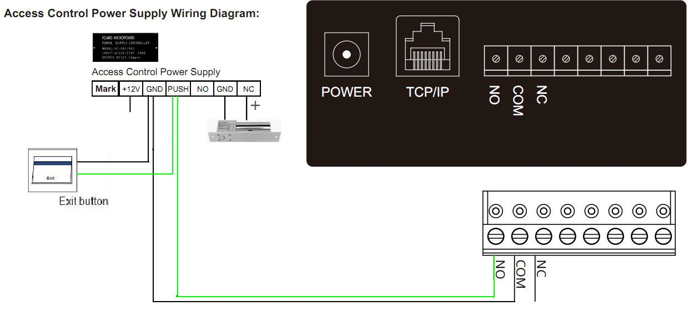
Wire Connecting Diagram

Slide 9
Firmware Upgrade
Before update:
Connect your pc with Facepass by TCP/IP, set your PC ip address and make sure your PC can connect to Device.
Prepare USB Host for update. copy all the file in folder2 to USB host root directory.
Start update:
Open web for Facepass http://192.168.0.218
  This is IP decide what you set in Facepass
  Username: admin password:88888888(default)
Update applications
Load sw2440_G1j_aws_V1.3.3.md5 and update it.
When finished , Facepass will reboot and change language to Spanish. you need change it to English if you are not good at Spanish.
Connect USB host with Facepass and update by USB.
  We need choose Upgrade Firmware.
Reload some configuration
Connect to the web of FACEPASS, load “lic.6553310335569_300_300_P1_C0_EC0_N0_L255.0” in folder2 and update it.
When finished, Firmware update finish.

Slide 10

Thank You
Anviz International Technical Support Team

