Slide 1

Anviz Online Training Lesson 3：GPRS Application
Anviz International Technical Support Team
Copyright © 2001-2013 Anviz Global Inc. USA

Slide 2


What is GPRS
GPRS Technology
GPRS (General Packet Radio Service) is the world's most common wireless data service, available now with almost every GSM network.

Slide 3
What is GPRS
GPRS is a connectivity solution based on Internet Protocols that supports a wide range of enterprise and consumer applications
With throughput rates of up to 40kbit/s, users have a similar access speed to a dial-up modem, but with the convenience of being able to connect from anywhere.
GPRS customers enjoy advanced, feature-rich data services such as Internet browsing, e-mail on the move, powerful visual communications such as video streaming, multimedia messages and location-based services.

Slide 4
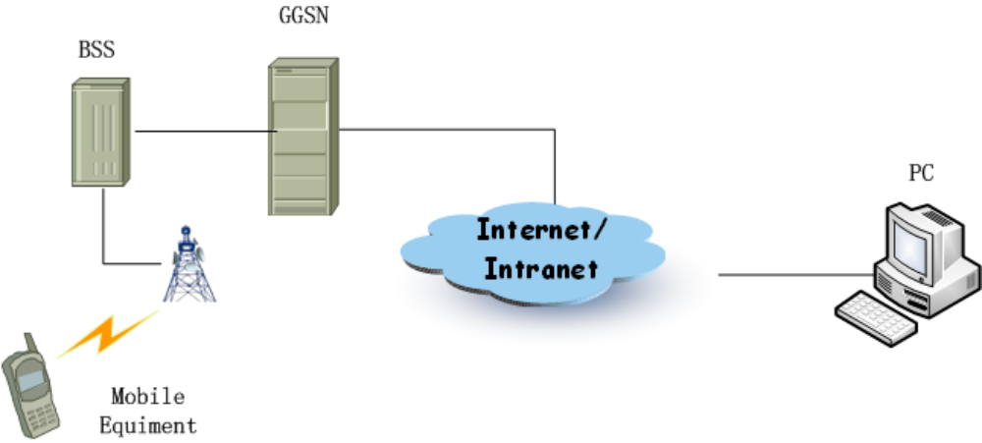
GPRS Network Topology
GPRS Technology
data PACKET

Slide 5
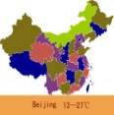






GPRS Application Area
GPRS Technology
Communication
Public information service
Position tracking
Security
Webpage browsing
Data transmission
Stocks
Real-time news
Static picture
Mobile bank
Personal information service
Web
FTP

Slide 6
ANVIZ GPRS MODEL
ANVIZ GPRS MODEL in Security
ANVIZ GPRS Model
Coal mine
Mountain
Remote door
Island
Remote attendance

Slide 7
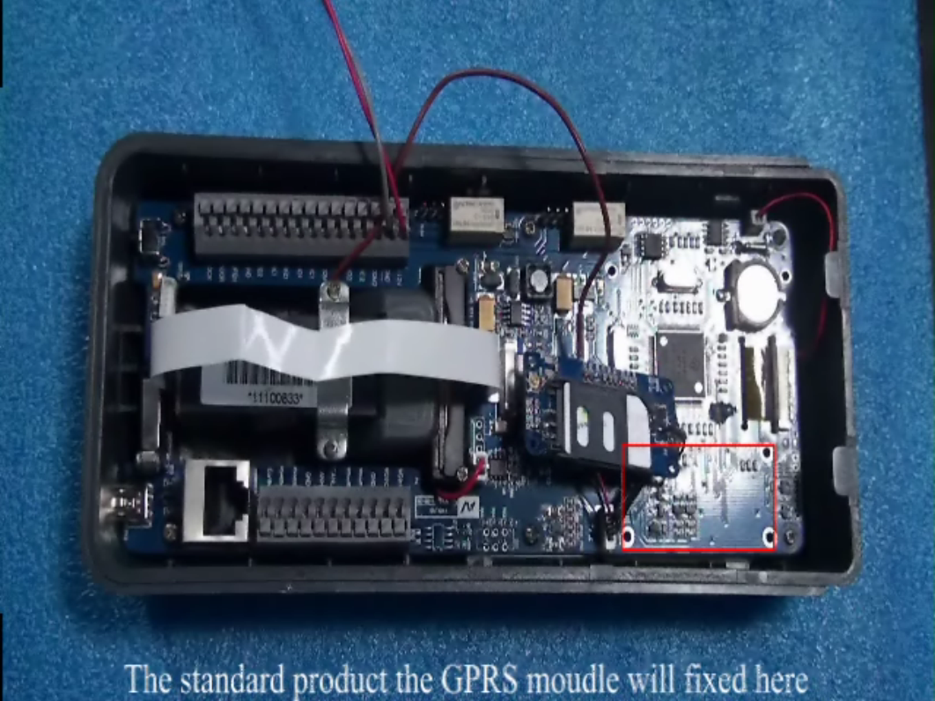
How to install GPRS MODEL in T60
ANVIZ GPRS MODEL
Power cable
SIM card

Slide 8
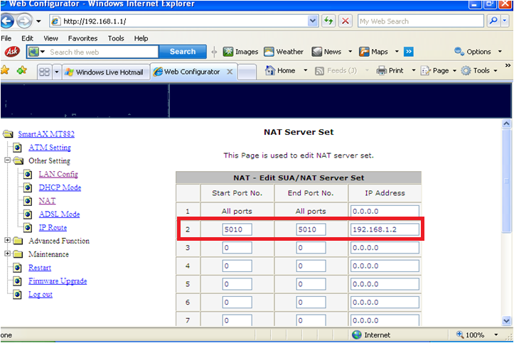
ANVIZ GPRS MODEL
NAT Setting in Router

Slide 9
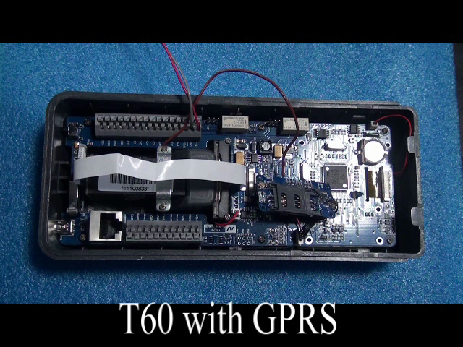
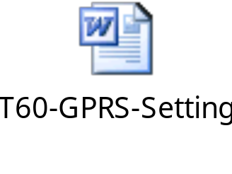
ANVIZ GPRS MODEL
How to SET GPRS MODEL in T60

Slide 10
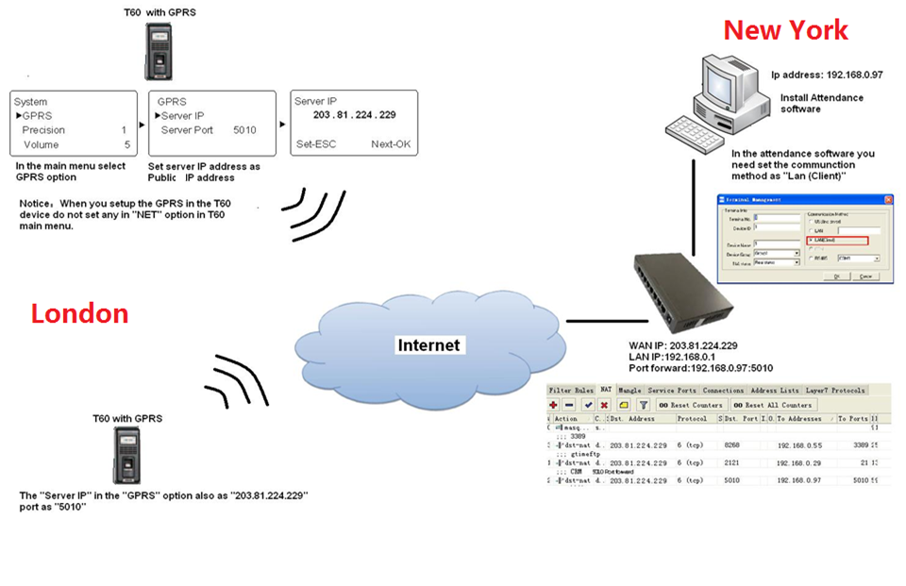
ANVIZ GPRS MODEL

Slide 11

Thank You
Anviz Technical Support Team

