Slide 1


Anviz Online Training Lesson 6：FAQ Analysis Process
Anviz International Technical Support Team
Copyright © 2001-2013 Anviz Global Inc. USA

Slide 2
FAQ
1.Refer to our homepage
http://www.anviz.com
2.Boot Failure
3.Screen Display
4.Register and Compare
5.Communication Failure
6.RMA

Slide 3
1.Refer to homepage 2.Boot failure 3.Screen display
4.Register and compare 5.communication failure 6.RMA
Boot failure has two features : can’t power on and blocked
Situations : 1.device can’t power on.
Solutions for VF30, VP30, T60, TC550, OC500, A300, EP300, OC180,
D100, D200 and more.
Step1: If you use USB for power supply , please change to external power supply
Step2：Check whether there is a identification caused by program, if yes, it can be
solved by upgrading firmware (introduced later)
Step3: If no, and can’t upgrade firmware, may be caused by hardware which can only be solved
by repair or changing mainboards.

Slide 4

1.Refer to homepage 2.Boot failure 3.Screen display
4.Register and compare 5.communication failure 6.RMA
Solutions for C2,C3,C2C and C5 (Set C2 as example caused by boot file loss):
Hold on button 1 and power on to see whether screen displays V1.19. If no , please change another power supply and the core boards or mainboards, or it need to be sent back. If it has V1.19, please do the following steps:
1.Open the FW_DN1.93_USB.exe. Then browse the file to add the TC.ROM file.

Slide 5
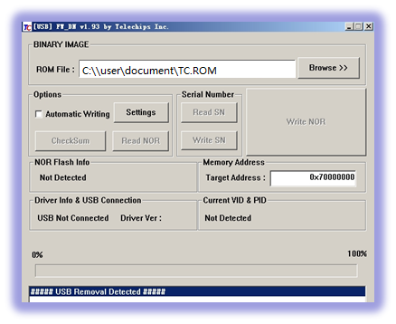


2.Run the install2000Xp.bat
3.Plug the USB into the PC USB port to get the connection. After this, you would see the follow shots.
4. Two holes on the P4(C3 is the J1 at the top), please use one conducting line to connect these as the pictures described.

Slide 6
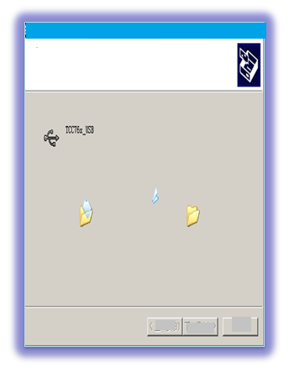
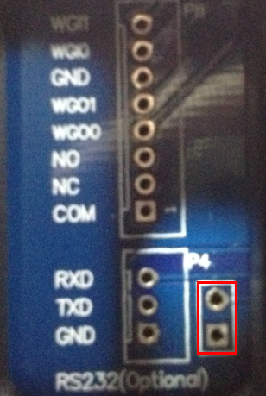
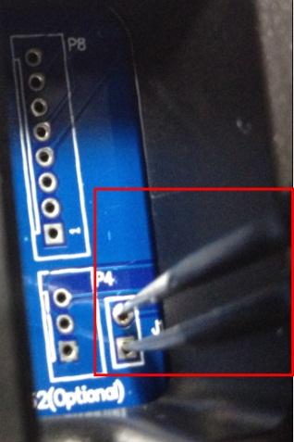
1.Refer to homepage 2.Boot failure 3.Screen display
4.Register and compare 5.communication failure 6.RMA
5.Then the last picture will appear there to click the Write NOR button.

Slide 7
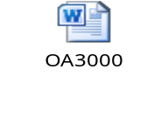
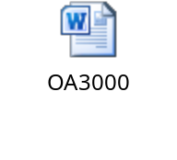

1.Refer to homepage 2.Boot failure 3.Screen display
4.Register and compare 5.communication failure 6.RMA
Sometimes we delete some files or whole firmware folder by mistake，and that would lead that the system would Hang up there while loading. The following steps are about how to resume firmware while firmware damaged.
Solutions:
Solutions for OA1000 and OA3000.(upgrade firmware)
OA1000 and OA3000 upgrade firmware in the same way, here we take OA3000 for instance.

Slide 8

1.Refer to homepage 2.Boot failure 3.Screen display
4.Register and compare 5.communication failure 6.RMA
Solutions for C2,C3,C2C and C5.
We can update our firmware by USB-disk and upgrade tool for C2 ,C3 or C2C.Upgrade via USB disk.
1
Create a folder named Anviz-c in the root directory of your USB disk.
Copy the firmware file named as TC.ROM to the Anviz-c folder.
3
Insert this USB disk to the C2 ,C3 or C2C.
4
5
6
7
There is a boot interface appearing , wait the programming finish and the device will automatic restart.
Just click OK button on the device .
Click OK button and wait the procedure upgrading to 100% then there is a popup prompts
Log in the main menu> USB Manage option>upload>upgrade
2

Slide 9
1.Refer to homepage 2.Boot failure 3.Screen display
4.Register and compare 5.communication failure 6.RMA
Situation 2: when power on, its display blocked in dual storage 0% or 100%,
or restart again and again, black screen of death(keypad ok). It may be
caused by program file or resource file loss.
Solutions for VF30, VP30, T60, TC550, OC500, A300, EP300, OC180,
D100, D200 and so on.(which may be caused by model set error .
so we can solve it by following ways:)

Slide 10

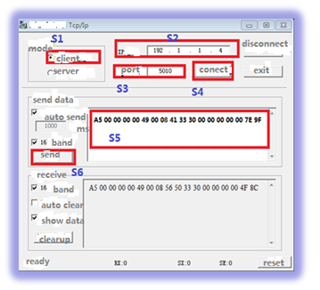
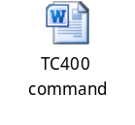
1.Refer to homepage 2.Boot failure 3.Screen display
4.Register and compare 5.communication failure 6.RMA
1.Resetting Model:
1.Connect via TCP/IP with software
2.Run the Network debugging assistant.exe
3.Do as the picture shows S1-S6,select all options
showed in picture.
Note:S2 set the IP address as your device set.
S3 set port as 5010.S5 set the model type with TC400 command which can be found in TC400 command.docx

Slide 11
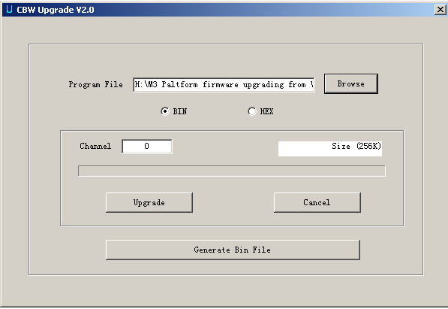
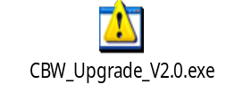
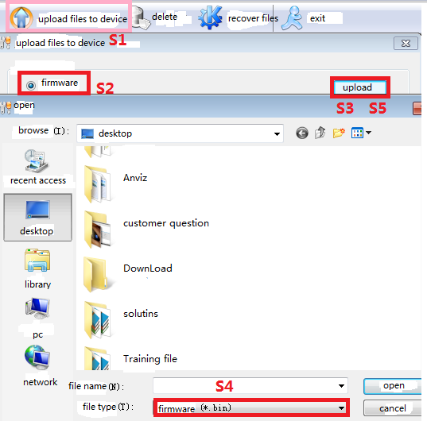
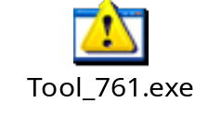
1.Refer to homepage 2.Boot failure 3.Screen display
4.Register and compare 5.communication failure 6.RMA
2.Firmware Upgrading
Upgrading tool: CBW_Upgrade_V2.0.exe
Click Browse to choose TC-M-02.29.bin
Click “Upgrade” to start upgrading.
Solutions for C2,C3,C2C and C5
Run the Tool_761.exe:
Do as picture shows:S1-S5
Note :the file format should be .bin.
Solution for OA1000/OA3000

Slide 12
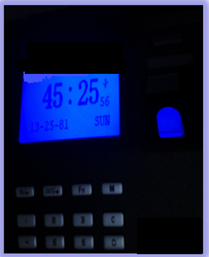

1.Refer to homepage 2.Boot failure 3.Screen display
4.Register and compare 5.communication failure 6.RMA
Screen display fault has two phenomenon : time loss and failure in showing certain language.
Phenomena1:
1.Each day/week the clock is over 30 minutes early
2.Time clock is stuck on date: 45.25.81 and time on 45:25:56
Solution for VF30, VP30, T60, TC550, OC500, A300, EP300, OC180,D100, D200 and so on.
Step1:Connect with communication software and synchronize successfully
Step2:Upgrade the firmware
Step3:Button battery power failure. Please change the battery.
Step4:Change the Electronic clock device or the mainboard

Slide 13
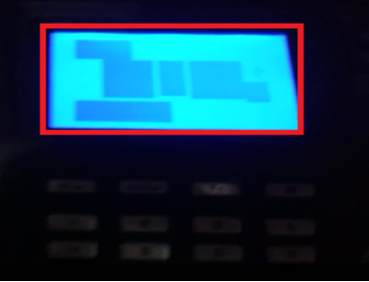
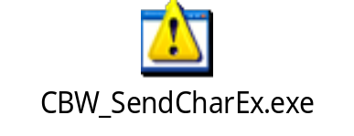
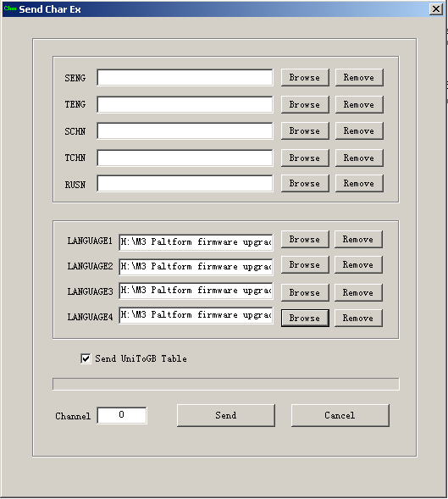

1.Refer to homepage 2.Boot failure 3.Screen display
4.Register and compare 5.communication failure 6.RMA
Phenomona2: for the former firmware uses unicode while later uses ASCII , sometimes it
can’t match so well, which causes faults of failure in showing certain language or fault as below:
Solution for VF30, VP30, T60, TC550, OC500, A300, EP300, OC180,D100, D200 and so on：character library upgrading
Upgrading tool: CBW_SendCharEx.exe
Click Browse to choose .bin file.
SENG must choose 1-SASCII.bin.
TENG must choose 2-TASCII.bin.
SCHN must choose 3-简体.bin.
TCHN must choose 4-繁体.bin.
RUSN must choose Rusin.bin.
Then ,click “Send” to start upgrading.

Slide 14
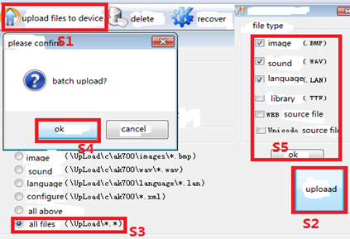
1.Refer to homepage 2.Boot failure 3.Screen display
4.Register and compare 5.communication failure 6.RMA
Solutions for C2,C3,C2C and C5
Run the Tool_761.exe:
Do as picture shows:S1-S5
Solutions for OA1000/OA3000(operate with device)
Power on---Setting---Device---Exit out---Wince OS---My device---Nand flash---OA1000/OA3000---Language---cover the file .lan with the new files.

Slide 15
1.Refer to homepage 2.Boot failure 3.Screen display
4.Register and compare 5.communication failure 6.RMA
Situations : sometimes FP is not read by device.
Reason | Solution
1. The fingerprint was not captured properly | Enroll the finger again. Please refer to illustration of pressing finger.
2. Direct sun light or too bright light | Avoid direct sun light or other bright light
3. Too dry finger | Use a little lotion or swipe your finger across your forehead to add some natural oil.
4. Too wet finger with oil or cosmetics | Clean fingers with towel
5. Low fingerprint quality with callus or peeling | Enroll a different finger with better fingerprint.
6. Wrong way in placing fingers when autenticating in/out | Please refer to illustration of pressing finger.
7. Latent fingerprint on the surface of sensor | Clean sensor surface (Adhesive Tapes Recommended)
8. Not enough finger pressure | Place the finger evenly on the sensor with moderate pressure
9. Influence by fingerprint image change | Enroll fingerprint again. Please refer to illustration of pressing finger.
10. Fingerprint not enrolled yet | Place enrolled finger.

Slide 16
1.Refer to homepage 2.Boot failure 3.Screen display
4.Register and compare 5.communication failure 6.RMA
Other Unusual Causes
1.Connecting wire of sensor loose
2.Backlight damage (lead to read automatically as well)
3.Infrared Emitting Diode sheltered
4.Prism fall off
5.Luminance of sensor is 0
6.Sensor damage

Slide 17
1.Refer to homepage 2.Boot failure 3.Screen display
4.Register and compare 5.communication failure 6.RMA
Situations for M3 devices
Q1:Failure in communication via USB or TCP/IP
WAY1:Modify the device ID as 0 or last 8 number of SN in software
WAY2:RS485
Q2:Admin or password loss
WAY1:Input device ID as 0,password as last 6 number of SN in device
WAY2: RS485

Slide 18
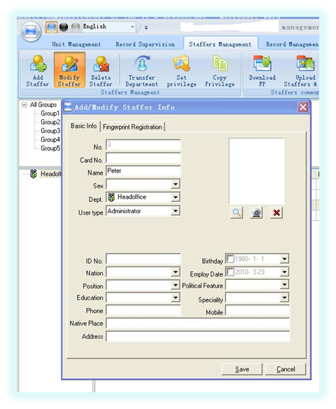
1.Refer to homepage 2.Boot failure 3.Screen display
4.Register and compare 5.communication failure 6.RMA
1.Connect the machine to the software.
2.Enter the “staffer management” page. Select the manager staffer and click the button “Modify Staffers” as follows:
3.Please change the manager’s user type from “Administrator” to “Normal user”.
4. Click the button “OK” to save the modification. And then upload the staffer information to the machine.
5. Now you can enter the machine’s menu by pressing the button “M” on the machine’s keypad directly.

Slide 19
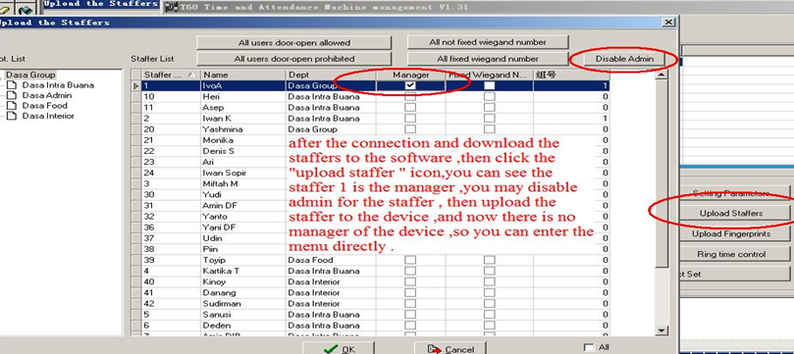
1.Refer to homepage 2.Boot failure 3.Screen display
4.Register and compare 5.communication failure 6.RMA
Case:T60 uses our old version software
Sometimes VF30 and T60 need the admin and password when connected
with software via USB and TCP/IP. Please try to input 0 as user and last 6 number
as password. Or try to connect via RS485.

Slide 20
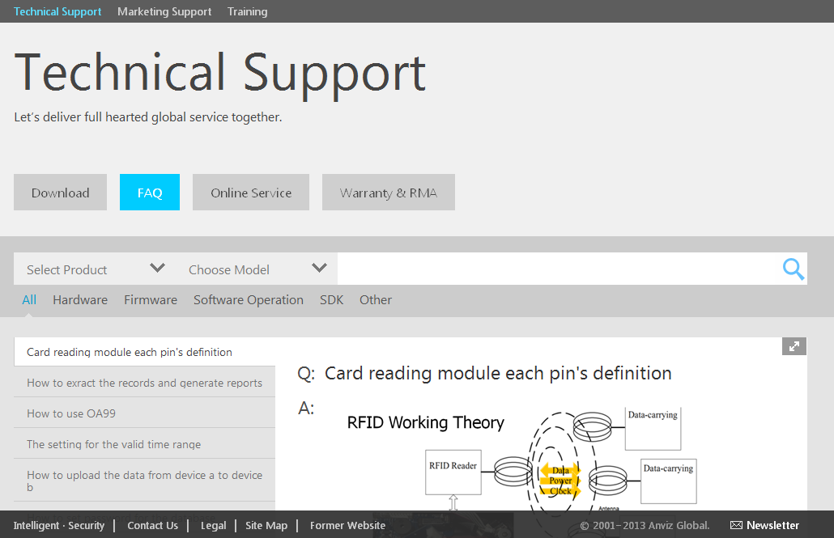
1.Refer to homepage 2.Boot failure 3.Screen display
4.Register and compare 5.communication failure 6.RMA
IF problems still not be solved , please submit it in our partner portal. Once needed to be send back to repair , please fill in the RMA first .
For more information about FAQ , please refer to
http://www.anviz.com/en-us/Faq/Index.html

Slide 21

Thank You
Anviz international Technical Support Team

