Slide 1

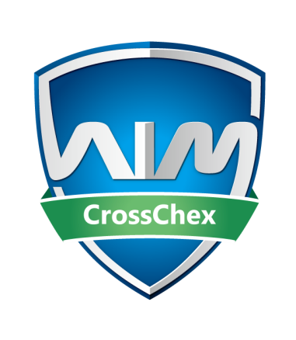
AIM CrossChex
-Standard Version
Anviz Online Training Lesson 7
Anviz International Technical Support Team
Copyright © 2001-2013 Anviz Global Inc. USA

Slide 2

What is AIM CrossChex
AIM is an Integrated Security Management System, supporting all Anviz biometric, surveillance and RFID products.
AIM CrossChex
AIM IntelliSight
……

Slide 3


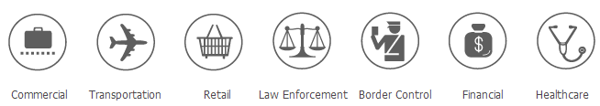
AIM CrossChex
-standard version
English Spanish Russian
Intelligent Management
Multi-shift management
Overtime
User defined reports
AIM CrossChex
Communication Management
Time & Attendance management software

Slide 4

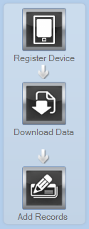


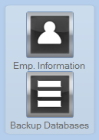
AIM CrossChex Homepage
This screen shows the basic workflow of CrossChex.
Company Configuration
Record
Report and Database
Employee Control

Slide 5
AIM CrossChex's Features
User-friendly and Intuitive interface makes operation easy and simple
Multi-department staff management provides shifts management, access control, and various types of report
Customizable settings of time attendance and access control meets different needs of various industries
Operating environment-Window XP，Windows7, and above

Slide 6
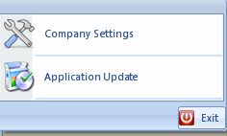


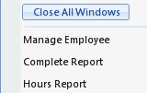
Software Improvements
Efficient Update
Optional Period
Access To Manual
Close All Windows

Slide 7
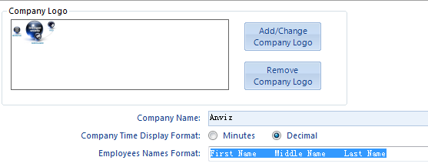

Software Operation
-Company Settings
Company settings must be configured before using the software.
Company Logo

Slide 8
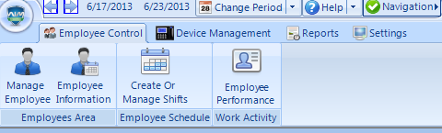
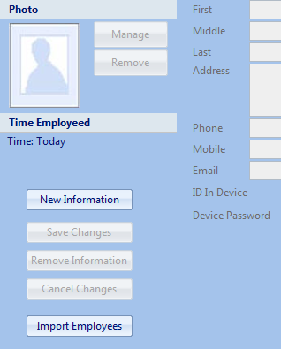
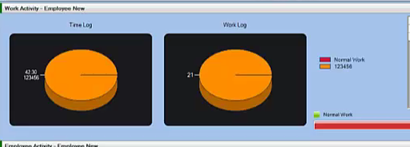
Software Operation
- Staff Management
Add Employee
Photo size is limited under 8KB
Work Activity
Visualization

Slide 9
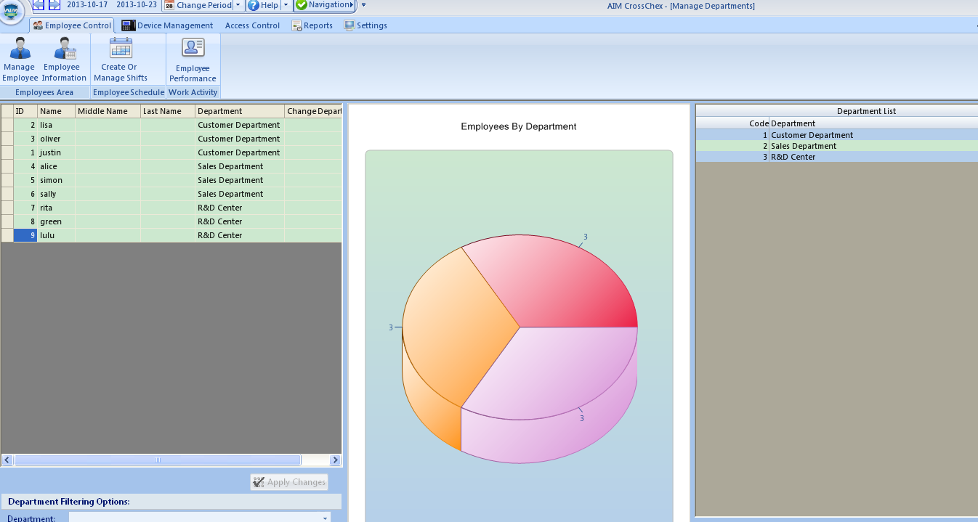
Software Operation
- Department Management
Department Management
Creat New Department
Allocate Department
Change Department

Slide 10
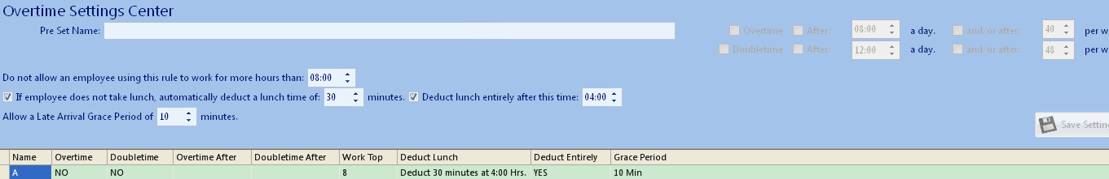
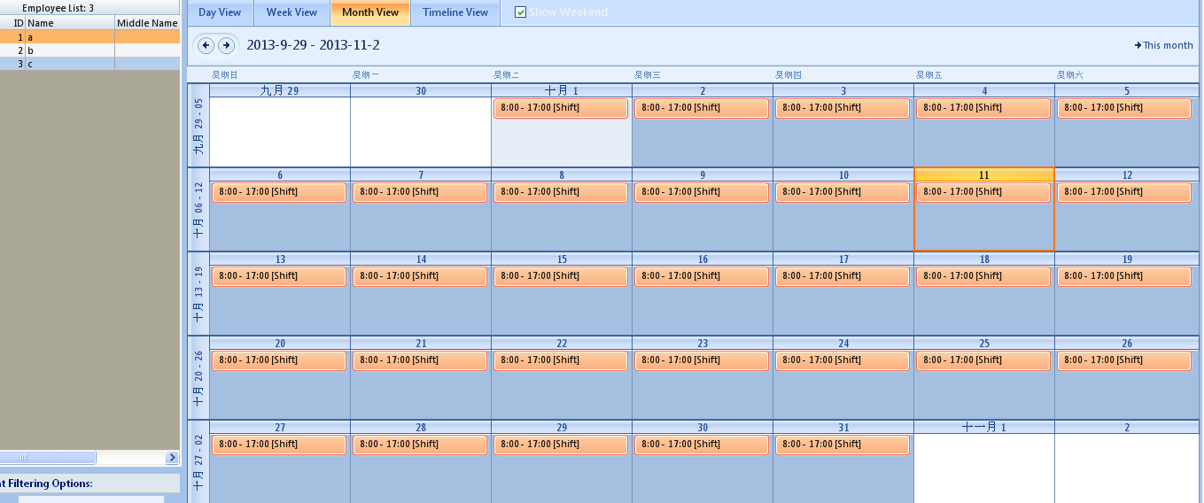
Software Operation
- Working Shift Management
Overtime Settings Center
Creat or Manage Shift
Create New Shift
Clean Shift
Modify Shift

Slide 11
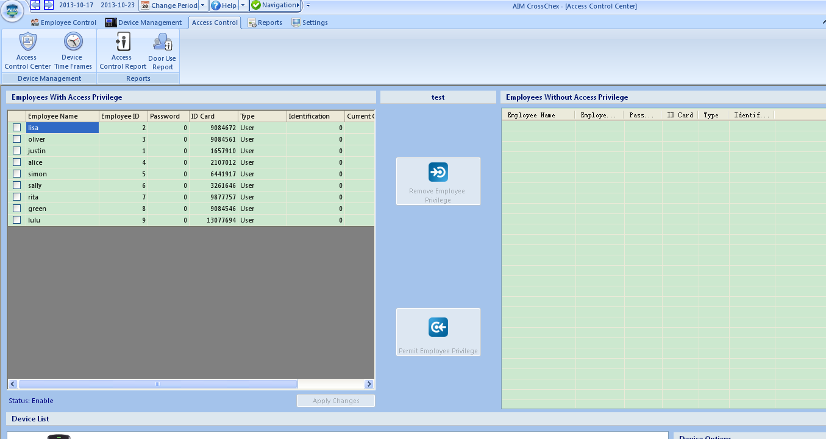
Software Operation
- Access Control management
Access Control Center
Employees’s access privilege of device can be permitted or removed.

Slide 12
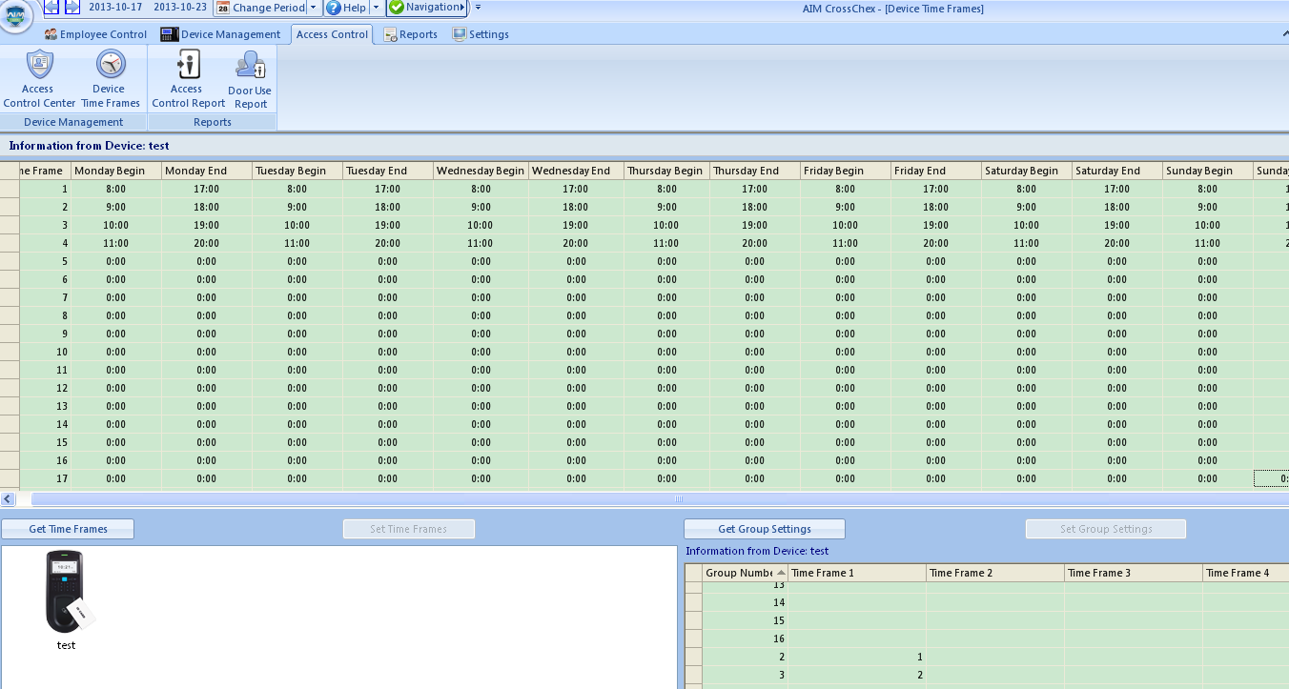
Software Operation
- Access Control management
Device Time Frames
Different Time Frames and Group Numbers are set according to applied requirements.

Slide 13
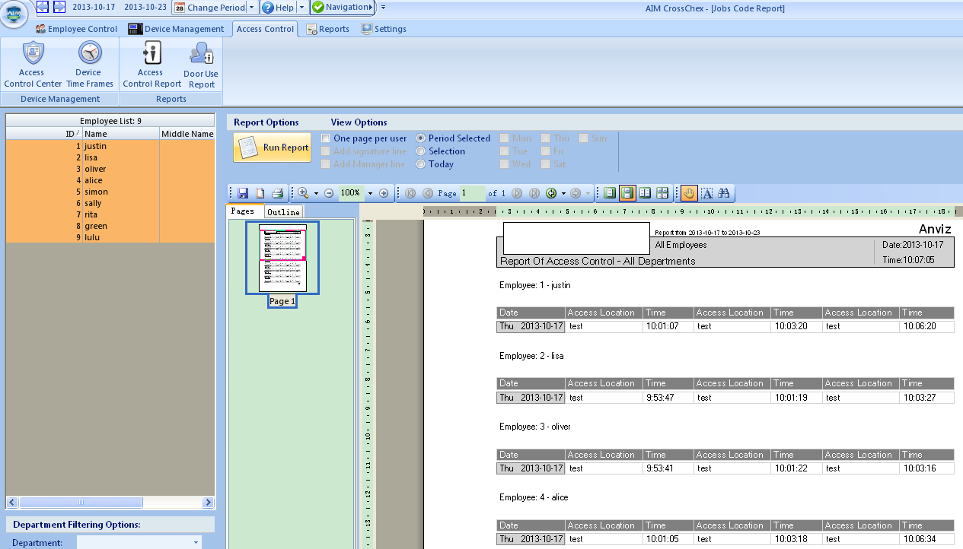
Software Operation
-Reports
Access Control Report
Various Reports can be run, calculated and exported, such as the one with signature line.

Slide 14
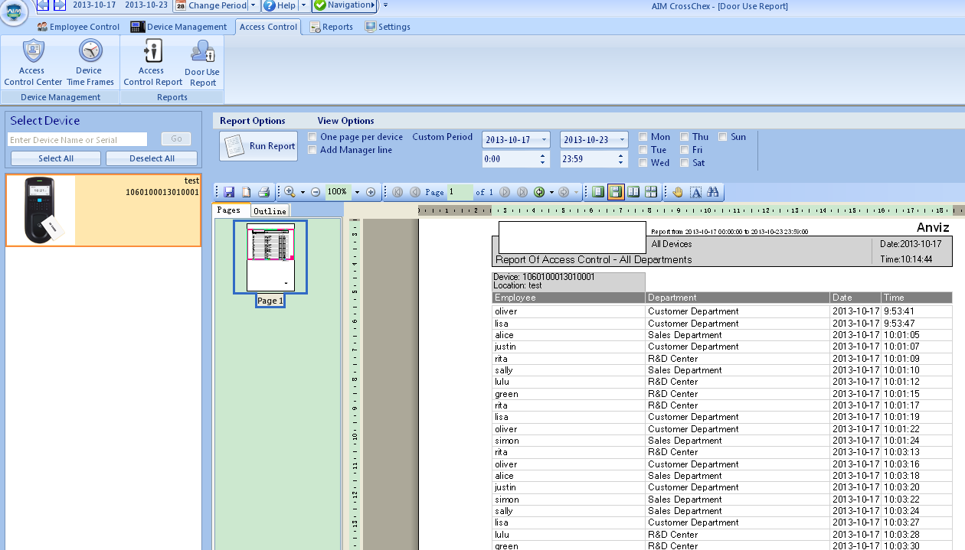
Software Operation
- Reports
Door User Report

Slide 15
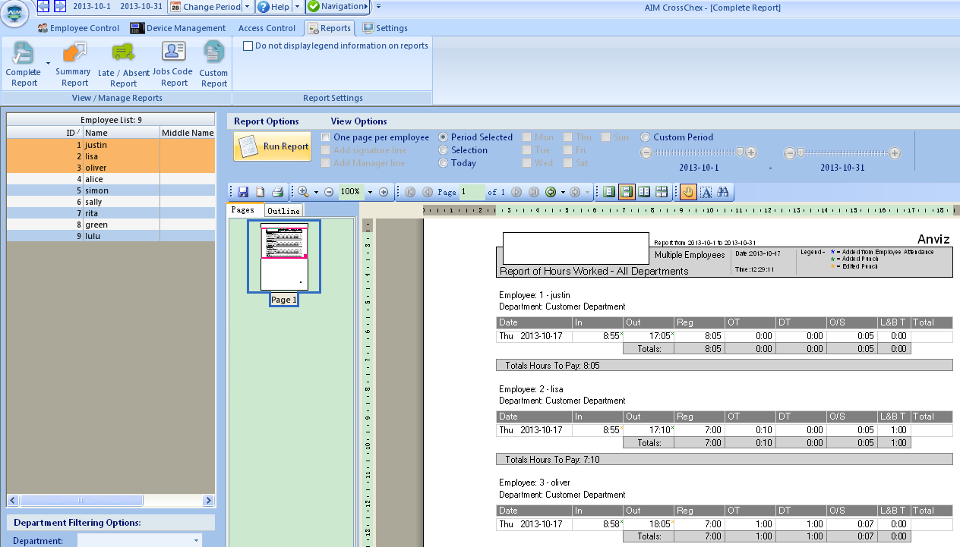
Software Operation
- Reports
Complete Report
This kind of report includes Location, In, Out, Regular Time (Reg), Over Time (OT),
Double Time (DT), Out of Shift (O/S), Lunch Break Taken (L&BT) and so on.

Slide 16
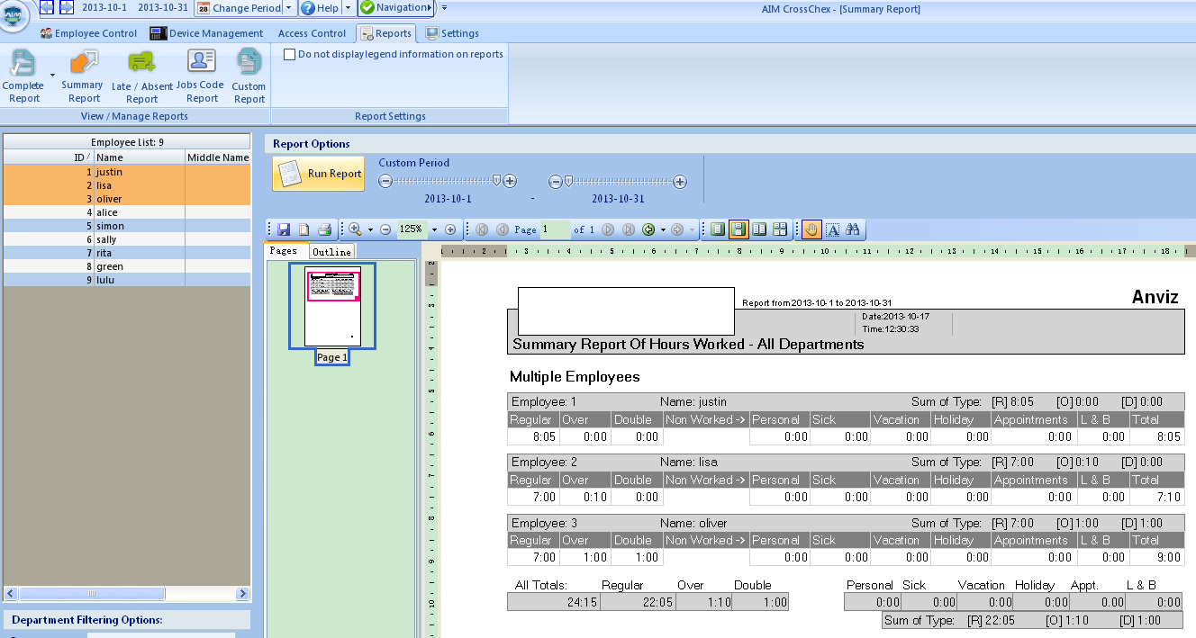
Software Operation
- Reports
Summary Report
Compared with Complete Report, it also includes Non-Worked records such as Personal Sick, Vacation, Holidays and Appointments and so on.

Slide 17
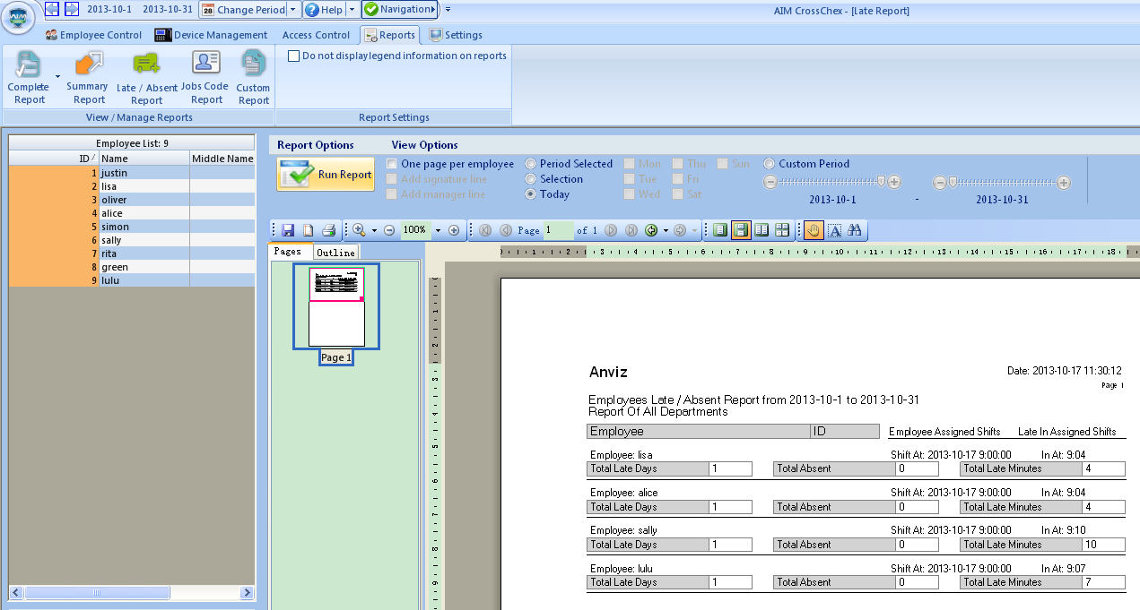
Software Operation
- Reports
Late / Absent Report

Slide 18
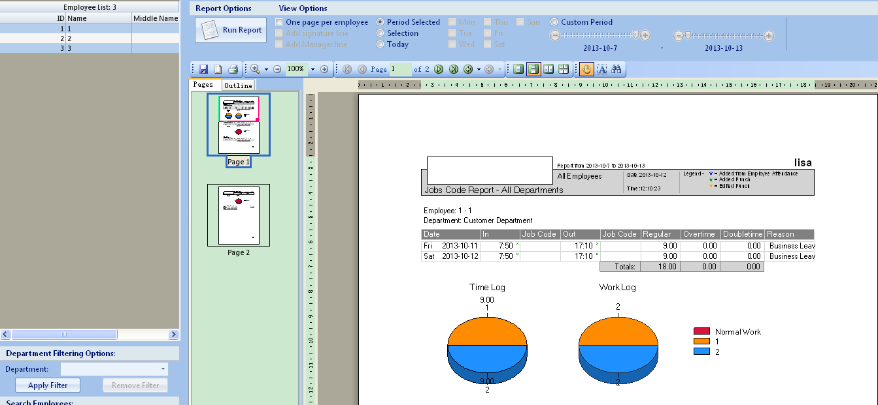
Software Operation
- Reports
Jobs Code Report

Slide 19
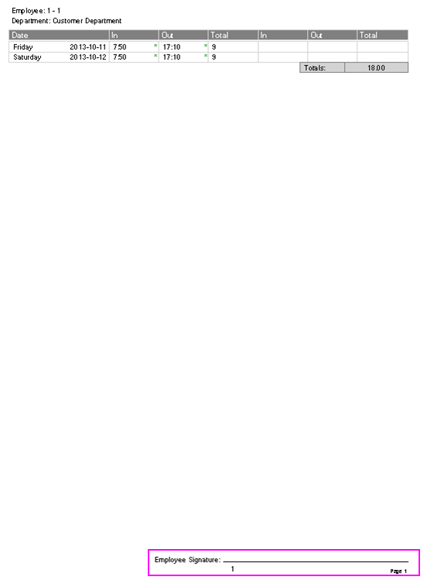
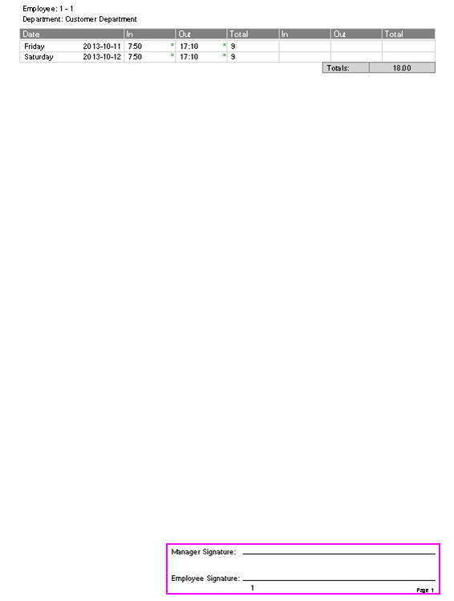
Software Operation
- Reports
Custom Report
Reports in different date and time tables and with signature line, manage line can be exported.

Slide 20
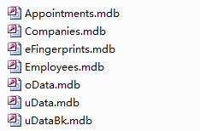
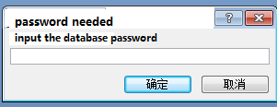
Encrypted Database
Microsoft Access Database
Microsoft SQL Database
Encrypt
Encrypt

Slide 21

Thank You
Anviz Overseas Technical Support Team

