Slide 1

Anviz Online Training Lesson 11： Anviz product remote access
Anviz International Technical Support Team
Copyright © 2001-2013 Anviz Global Inc. USA

Slide 2

LAN WAN GPRS WIFI
Anviz Communication
Method
TCP/IP
USB
LAN/WAN
WIFI
GPRS

Slide 3
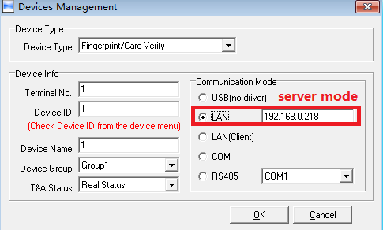
LAN WAN GPRS WIFI
This solution helps the program one computer in a place control several terminals in same place(same network in router or switch).
Server mode
For example set in the terminal VF30, menu→setup→system→net:
IP address:192.168.0.55 (in the same IP segment with pc)
Subnet mask:255.255.255.0(same with pc)
MAC address: default Server IP: Random
Gateway IP:192.168.0.1(same with pc)
If you want to connect several terminals , you just need to modify the IP
address in software one by one

Slide 4
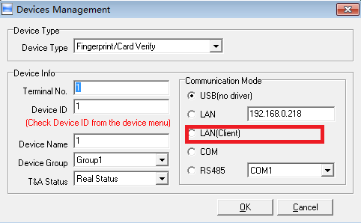
LAN WAN GPRS WIFI
Client mode
IP address:192.168.0.55 (distributed by router)
Subnet mask:255.255.255.0 (same with pc)
MAC address: default
Gateway IP:192.168.0.1 (same with pc)
Server IP: PC IP address
Server port:5010 (you have forwarded to the pc)

Slide 5
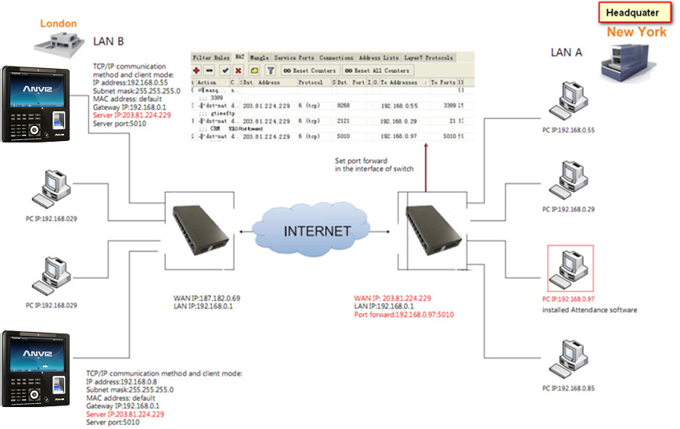
LAN WAN GPRS WIFI

Slide 6
LAN WAN GPRS WIFI
Solution for remote communication
This solution helps the program one computer in a place control several terminals in different place.
1. Please select client mode as the TCP/IP communication method. It will provide a easy and steady communication.
All settings are in Net option.
IP address: 192.168.0.55 (device IP address)
Subnet mask: 255.255.255.0 (same with pc) MAC address: default
Gateway IP: 192.168.0.1 (the router IP)
Server IP: Public IP of the switch, in which the computer with attendance software.
  For example 203.81.224.229 (The controlling part in head office)

Slide 7
LAN WAN GPRS WIFI
Server port: 5010 (you have forwarded)
Then connect to switch with RJ45 in one LAN. If the switch has a public IP address and its gateway IP is 192.168.0.1. we can pen the LAN IP 192.168.0.55 and port 5010 in the interface of switch menu.
2. Set port forward 5010 in the switch in which the computer with attendance software . we must set port forward in the interface of switch menu.
All settings are in Net option.

Slide 8
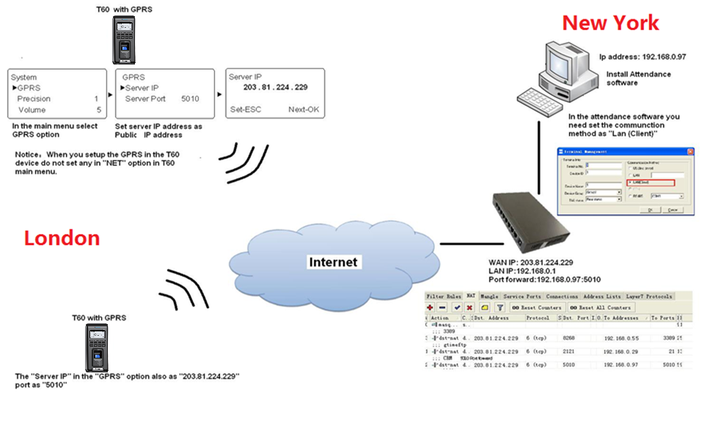
LAN WAN GPRS WIFI

Slide 9
LAN WAN GPRS WIFI
T60
Insert the standard SIM card. (The SIM for IPhone is a small one) and power on the T60 device.
2. T60 device will search the GPRS signal. (GPRS module support 900/1800/1900 MHZ)
IN
09 : 00 26
12-16-10 THU
IN
09 : 00 26
12-16-10 IIII THU
System
GPRS
Precision 1
Volume 5
3. After the device gets the GPRS signal. (better has level 3 signal or above, then you will have a stable connection and less packet loss when transferring data)
4. All network settings are in GPRS option

Slide 10
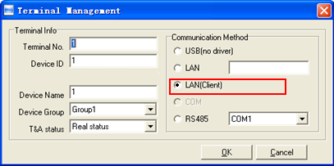
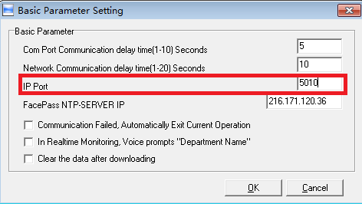
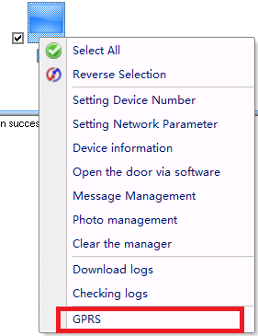
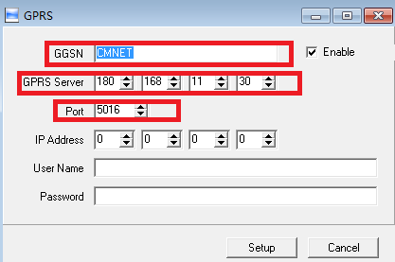
LAN WAN GPRS WIFI

Slide 11
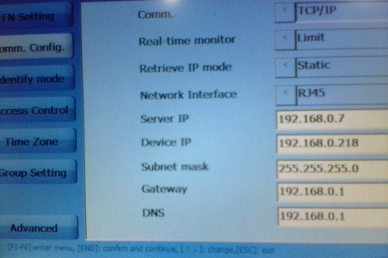
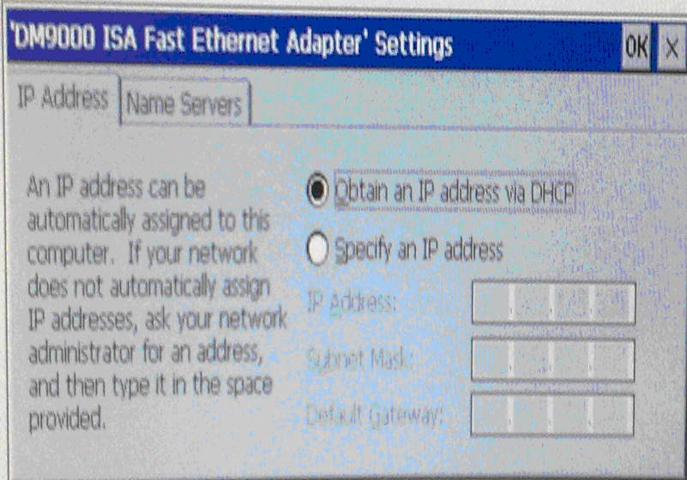
LAN WAN GPRS WIFI
OA1000
1.After setting the device to connect to Internet successfully, power off the device , and restart it . then get to the menu “advanced -----Comm.config’ , you may find this image :
2 Then exit to the OA3000 desktop , and you may find next menu .
Start----Setting----Control Panel------Network and Dialup Connection----DM9CE1, and open DM9CE1
file , and you may find the image . And select “ Obtain an IP address via DHCP”, and then press OK to exit .
3 Active the server/Router 5010 port as next image.

Slide 12
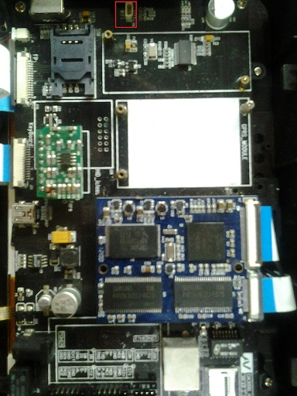
LAN WAN GPRS WIFI
OA1000/3000 WIFI communication method instruction
1. Before power on the device, please check the WIFI module and the cable , check it loose or fall and on the PC select the wireless communication to the router .
2. Make sure all hardware components are conected, then power on the device , (system—device set—exit ) and exit to WINCE system screen . then double click the NET icon (right bottom position) .

Slide 13
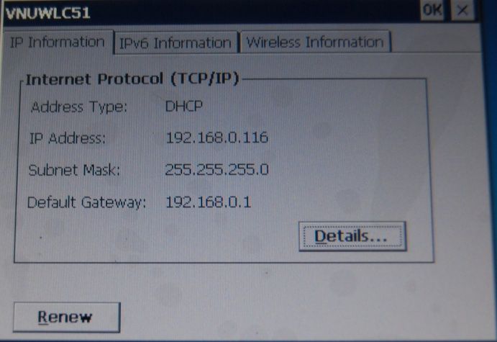
LAN WAN GPRS WIFI
3. Then select the “wireless information” menu, select the “ZhongJian (preferred)“ , then select “Connect“ menu. When the status shows : connected to ZhongJian.
Signal strength shows: excellent. It means the device connect to the “wireless router” successfully.
4. Then get to the “IP information” menu , you may find next image, it shows the IP address of the server automatic setting .

Slide 14
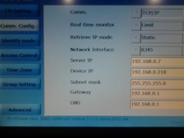
LAN WAN GPRS WIFI
5. Get to the device time attendance software, My device –Nandflash –OA1000/3000—Fptouch1000.exe.Menu: Advance ---Comm Config, set it as the follow image :
The server IP: just as the PC IP address.
6. Then get to the PC time attendance software , and set the communication successfully.

Slide 15
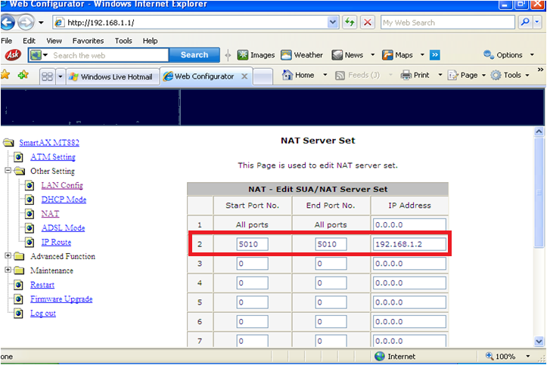
Some Explanation
NAT Setting in Router

Slide 16
Some Explanation
1）Communication method：client.
2）Once terminal sent data to PC with software, PC remember the path and can sent commands to terminal by the reversed path.
3）The Switch in LAN A need have a static public IP address. And one port of the Switch need to bind the port for communication with the Software.
4）In the software you need enter the serial number (Device ID). Do not need any IP address.
5）Because of our software and device transfer the data via the bound port.
6）If the computer with attendance software is not in LAN in server mode and has its public IP address, you do not need to set port forward and just put the public IP address in the Server IP in the device.

Slide 17

Thank You
Anviz Technical Support Team

